Slide 1
IBM
Tools for Data Science

Slide 2
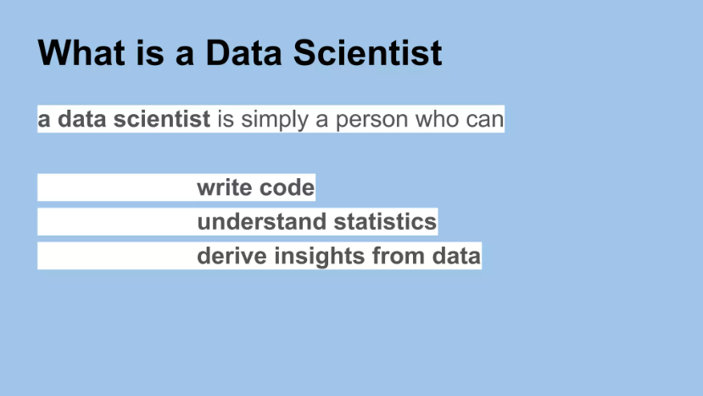

Slide 3
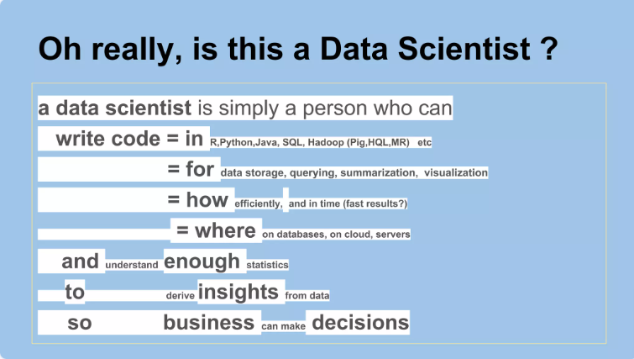

Slide 4
In this course you will learn how to:
Describe the Data Scientist’s tool kit which includes Libraries & Packages, Data sets, Machine learning models, and Big Data tools.
Utilize languages commonly used by data scientists like Python, R, and SQL
Demonstrate working knowledge of tools such as Jupiter notebooks and RStudio and utilize their various features.
Create and manage source code for data science using Git repositories and GitHub.
Course Modules:
Overview of Data Science Tools
Languages of Data Science
Packages, APIs, Database & Models
4. Jupyter Notebooks and Jupyter lab
5. RStudio & GitHub
6. IBM Watson Studio

Slide 5
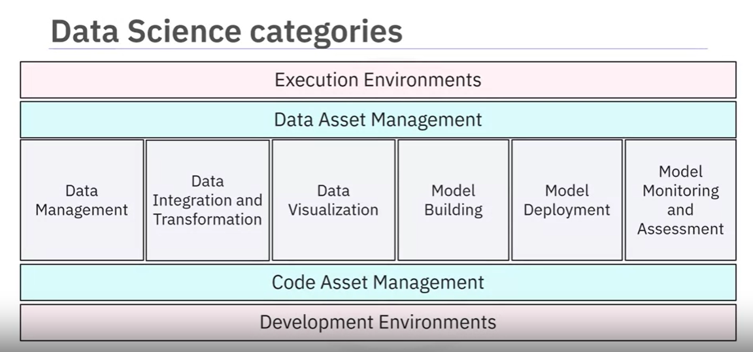

Slide 6
Data Science Task Categories
Data Management: Collect, persist, and retrieve data securely and efficiently from various sources like social media and sensors.
Data Integration and Transformation (ETL): Extract data from multiple repositories, transform its values and structure, and load it into a central Data Warehouse.
Data Visualization: Graphical representation of data using charts, plots, maps, etc., for effective decision-making.
Model Building: Train data with machine learning algorithms to analyze patterns and make predictions.
Model Deployment: Integrate developed models into production environments via APIs for data-based decision-making.
Model Monitoring and Assessment: Continuous quality checks to ensure model accuracy, fairness, and robustness.

Slide 7
Supporting Tools and Environments
Code Asset Management (GitHub): Version control and collaboration for managing code files and project updates.
Data Asset Management (DAM Platforms): Organize and manage data collected from different sources with versioning and collaboration support.
Development Environments (IDEs): Provide workspace and tools for developing, testing, and deploying source code.
Execution Environments (Cloud-based): Libraries for compiling source code and resources for executing and verifying code.
Fully Integrated Visual Tools (IBM Watson Studio, Cognos): Cover all aspects of data science tasks and enable deep learning and machine learning model development.

Slide 8
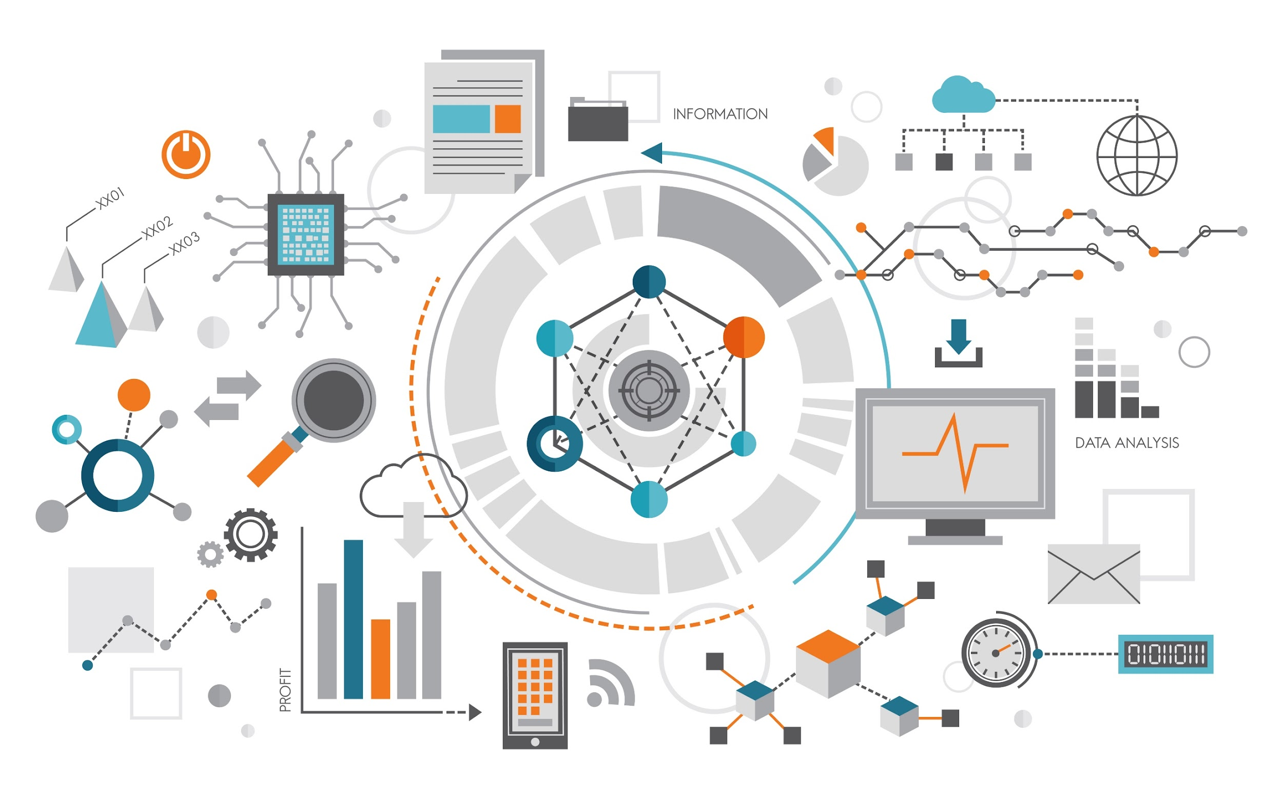
Tools for Data Science
Module I: Overview of Data Science Tools

Slide 9
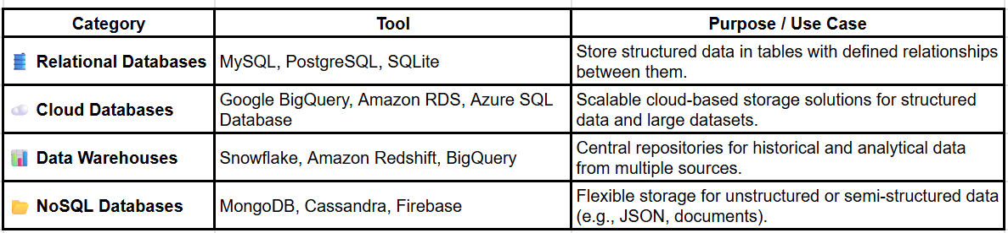
Data Management Tools
MySQL (in course)

Slide 10
Open-Source Data Management, Integration, and Visualization Tools
Data Integration and Transformation Tools:
Termed: Data Refinery and Cleansing
Pandas (in course)
Apache AirFlow, KubeFlow
Apache Kafka, Apache Nifi, Apache SparkSQL
NodeRED
Data Visualization Tools:
Matplotlib & Seaborn (Python) (in course)
Tableau (Good to try it and test)
Power BI (Good to try it and test)
PixieDust, Hue
Kibana
Apache Superset
Notes:
updated red lines

Slide 11
Model Tools, Deployment, and Monitoring
Model Tools for Building,
Scikit-learn (as we need in a course)
TensorFlow & Keras (as we need in a course)
PyTorch (as we need in a course)
Model Tools Deployment
Amazon SageMaker, Google AI Platform, Azure Machine Learning
Flask & FastAPI (in course)
Streamlit (in course)
Apache PredictionIO, Seldon
Kubernetes, Redhat OpenShift, Mleap
TensorFlow Tools
TensorFlow service, TensorFlow lite, TensorFlow dot Js

Slide 12
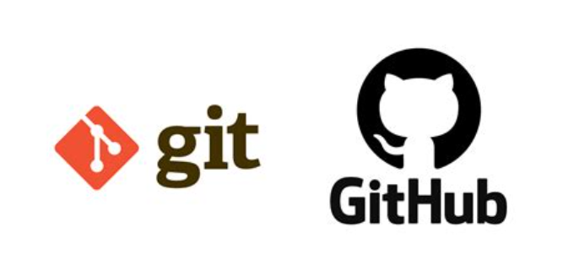
Model Monitoring Tools:
MLflow (in course)
ModelDB, Prometheus
IBM AI Fairness 360, IBM Adversarial Robustness 360 Toolbox
IBM AI Explainability 360
Code Asset Management Tools:
Git Version Control
GitHub (self working in course)
GitLab, Bitbucket
Data Asset Management Tools
Apache Atlas, ODPi Egeria, Kylo

Slide 13
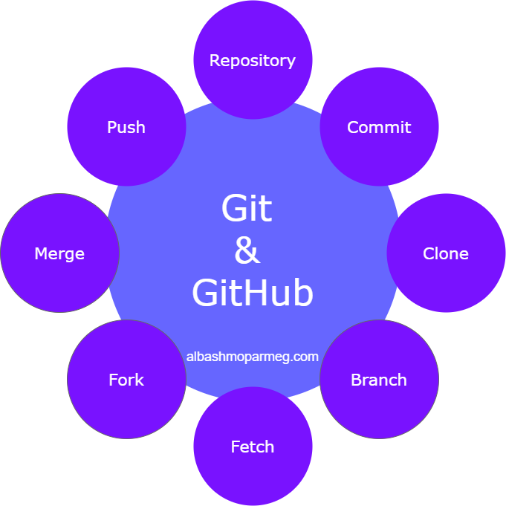

Slide 14
Development Environments and Execution Environments
Development Environments:
Anaconda,Jupyter Notebook & lab (using in course)
Spyder
RStudio
Execution Environments:
Docker
AWS SageMaker
Google Cloud AI Platform
Watson Studio Desktop for data science development
Watson Studio, Watson Open Scale for fully integrated data science lifecycle
Apache Spark, Apache Flink, Ray
Fully Integrated Visual Tools: KNIME, Orange

Slide 15
Commercial Tools for Data Science
Module I: Overview of Data Science Tools

Slide 16
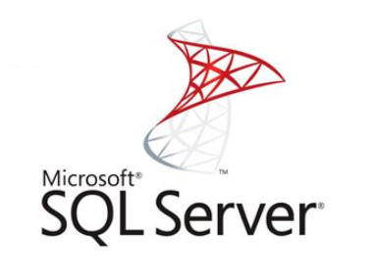
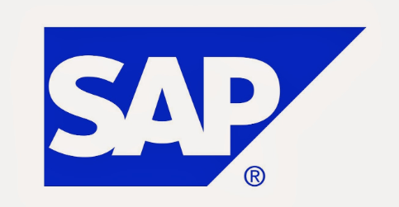

Commercial Data Management, Integration, and Visualization Tools
Data Management Tools:
Oracle Database
Microsoft SQL Server
IBM Db2
Data Integration Tools:
Informatica PowerCenter
IBM InfoSphere DataStage
SAP, SAS, Talend, Microsoft
Data Visualization Tools:
Tableau
Microsoft Power BI
IBM Cognos Analytics

Slide 17
Model Tools, Deployment, Monitoring, and Fully Integrated Solutions
Model Tools for Building and Deployment:
SPSS Modeler
SAS Enterprise Miner
Model Deployment and Monitoring:
SPSS Collaboration and Deployment Services
PMML format for model export
Code and Data Asset Management Tools:
Informatica Enterprise Data Governance, IBM tools for data asset management
Development Environment and Fully Integrated Tools:
Watson Studio Desktop for data science development
Watson Studio, Watson Open Scale for fully integrated data science lifecycle

Slide 18
Cloud Based Tools for Data Science
Module I: Overview of Data Science Tools

Slide 19
Cloud-Based Tools for Data Science Overview
Fully Integrated Visual Tools:
Watson Studio & Watson OpenScale
Microsoft Azure Machine Learning
H2O Driverless AI
Data Management in the Cloud:
SaaS versions of open-source and commercial tools
Examples: AWS DynamoDB, Cloudant, IBM Db2
Cloud Data Integration Tools:
Informatica Cloud Data Integration
IBM Data Refinery (in Watson Studio)

Slide 20
Cloud-Based Data Visualization and Model Tools
Cloud Data Visualization Tools:
Datameer
IBM Cognos Business Intelligence Suite
Data exploration and visualization in Watson Studio
Model Building and Deployment:
Watson Machine Learning
Amazon SageMaker Model Monitor
SPSS Collaboration and Deployment Services

Slide 21

Module II Packages, APIs, Datasets and Models

Slide 22
Libraries for Data Science
Module II: Packages, APIs, Datasets and Models

Slide 23
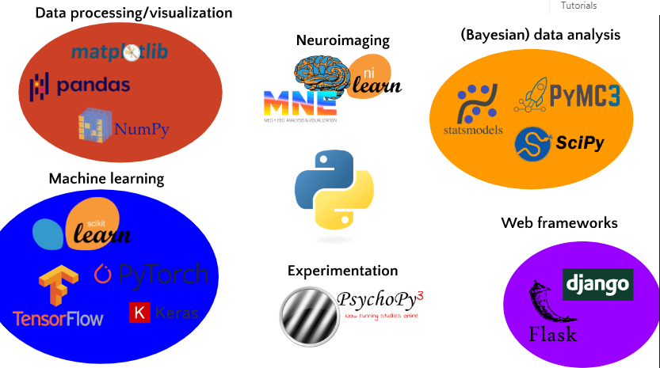

Slide 24
Python Libraries for Data Science
Scientific Computing Libraries: Includes Pandas for data cleaning and manipulation, offering data structures like Data Frames.
Visualization Libraries: Matplotlib for customizable graphs and charts, Seaborn for heat maps and violin plots.
High-Level Machine Learning Libraries: Scikit-learn for regression, classification, and clustering tasks.
Deep Learning Libraries: Keras for quick model building, TensorFlow for large-scale deep learning production.
Other Languages Libraries: LangChain, Transformers, R and Scala.

Slide 25
Complementary Libraries and Tools
Scala Libraries: Vegas for statistical data visualizations, complementary to Apache Spark.
R Libraries: ggplot2 for data visualization, interfaces with Keras and TensorFlow for deep learning.
Advantages of Python: Python libraries and frameworks are replacing R in open-source data science.
Interfacing with TensorFlow: Libraries in R that allow seamless integration with TensorFlow.
Apache Spark Capabilities: Supports data processing in parallel using compute clusters in various languages.

Slide 26
Application Programming Interfaces (APIs)
Module II: Packages, APIs, Datasets and Models

Slide 27
What is an API?
API stands for Application Programming Interface.
It allows different software applications to communicate and share data.
Works like a translator between two systems, enabling them to work together.

Slide 28
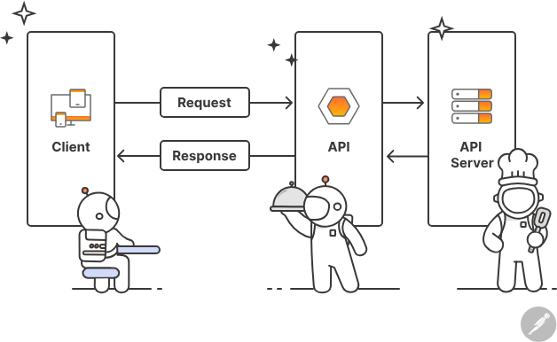

Slide 29
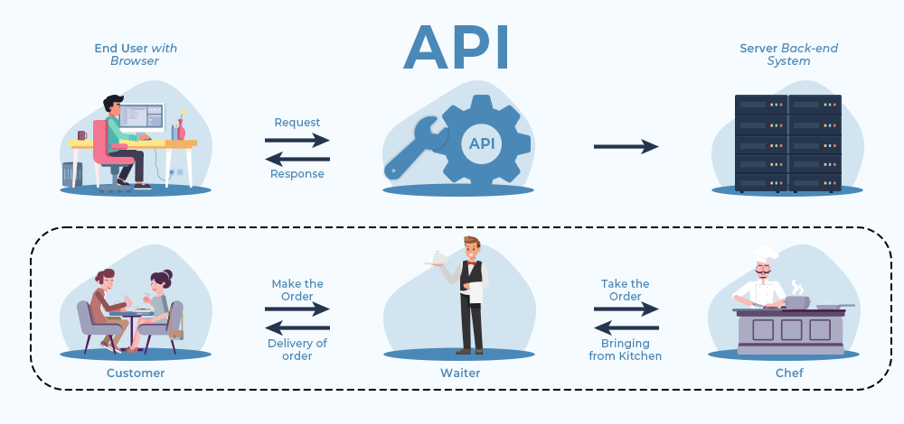

Slide 30
How APIs Work: Request-Response Cycle
API Client:
The application sending a request.
Example: A mobile app asking a server for data.
API Server:
The system that receives the request and processes it.
Example: A database or web server that holds the requested information.

Slide 31
API Request Components
Endpoint: The URL where the API can be accessed (e.g., /users).
Method: The type of request (e.g., GET, POST, PUT, DELETE).
Parameters: Information passed to the API, either in the URL or the request body.
Headers: Extra information like authentication or content type.
Body: Data sent with the request (only for POST and PUT methods).

Slide 32
API Response Components
Status Code:
Indicates the result of the request (e.g., 200 OK, 404 Not Found).
Headers:
Additional information like content type.
Response Body:
The actual data returned by the API or an error message.
https://developer.mozilla.org/en-US/docs/Web/HTTP/Status#redirection_messages

Slide 33
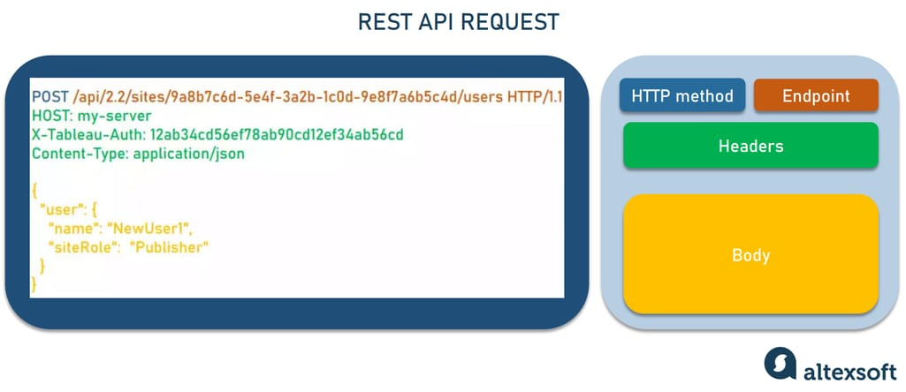

Slide 34
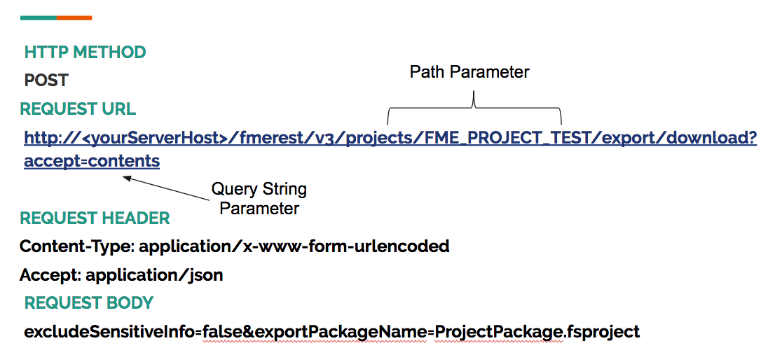

Slide 35
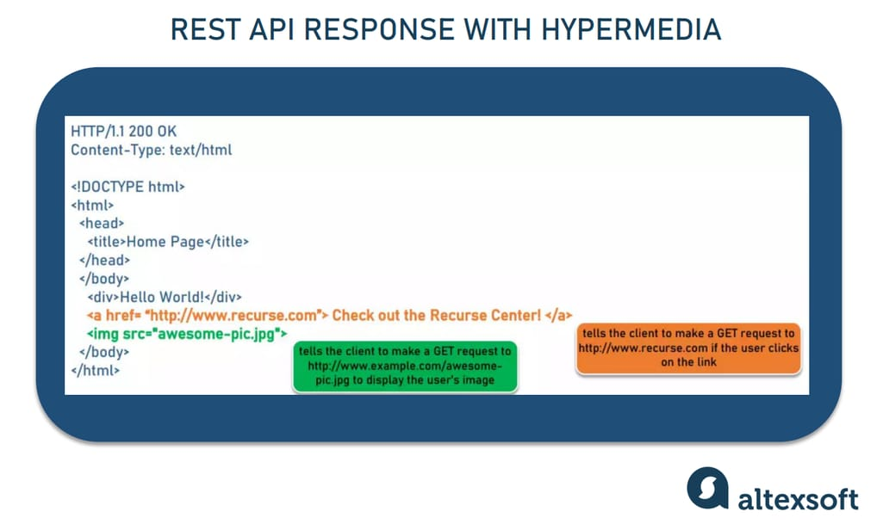

Slide 36
Example of API in Action
User searches for a product in an e-commerce app.
The API Client (app) sends a GET request to the server.
The API Server returns product details as a Response.
The Client displays the results to the user.

Slide 37
API architectural styles
REST API: A simple and widely-used design pattern for communicating over HTTP between applications using standard methods like GET and POST.
FastAPI: A modern, very fast Python framework for building APIs, offering automatic documentation and high performance.
GraphQL: A flexible query language that allows you to request exactly the data you need from a server.
gRPC: A high-performance framework by Google that uses HTTP/2 to efficiently exchange data between services.

Slide 38
API architectural styles
SOAP: An older and reliable protocol that uses XML to transfer data, ideal for sensitive systems like banking.
JSON-RPC: A lightweight protocol based on JSON for performing remote procedure calls between applications.
OData: A protocol that uses HTTP to query and manipulate data in a way similar to SQL.
OpenAPI/Swagger: A standard for documenting and designing REST APIs with an interactive interface for easier understanding and use.

Slide 39
Data Sets - Powering Data Science
Module II: Packages, APIs, Datasets and Models

Slide 40
Data Sources and Licensing
Data Sources: From public entities, organizations, companies, and online communities like Kaggle.
Open Data Access: Facilitated by websites and portals offering a wide range of information.
Community Data License Agreement (CDLA): Addresses licensing terms for open data distribution.
CDLA-Sharing License: Grants permission to use and modify data with sharing conditions.
CDLA-Permissive License: Allows data use and modification without sharing changes.
Impact on Data Science: CDLA supports open data sharing without imposing restrictions on derived results.

Slide 41
Introduction to Data Asset eXchange (DAX)
Overview of DAX: IBM's open data repository for high-quality data sets.
Purpose of DAX: Curates open data sets with clear license and usage terms.
Data Variety: Includes images, video, text, and audio data for enterprise applications.
Community Data License Agreement (CDLA): Ensures data sets are available for collaboration.
Tutorial Notebooks: Provide guidance on data cleaning, preprocessing, and analysis.
Advanced Notebooks: Cover complex tasks like machine learning and statistical analysis.

Slide 42
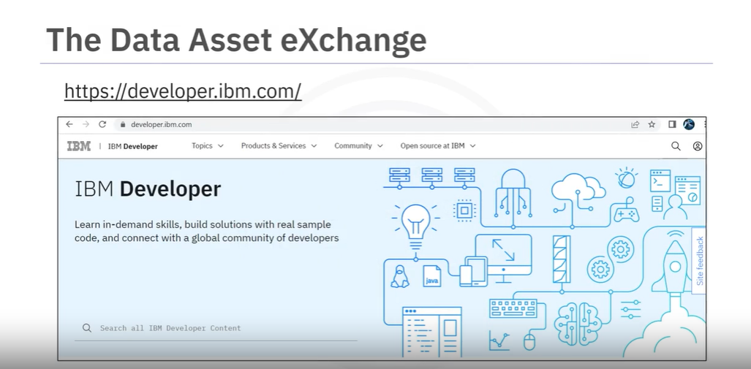
https://developer.ibm.com/exchanges/data/

Slide 43
Navigating Data Asset eXchange (DAX)
Accessing DAX: Visit IBM Developer website and select Data Asset eXchange.
Data Exploration: Explore multiple open data sets on DAX for various purposes.
Downloading Data: Easily download data sets like "NOAA Weather Data - JFK Airport."
Notebook Integration: Use notebooks in Watson Studio for data analysis and processing.
Data Files: Access data files associated with data sets for further analysis.
IBM Developer Resources: DAX and Model Asset eXchange (MAX) available for developers.

Slide 44
Introduction to Watson Studio
Collaborative data science platform: Unites data scientists, developers, and analysts.
Build, run, and manage AI models: Develop and deploy machine learning models.
Open-source tools and languages: Integrates with popular open-source tools and languages.
Scalable on cloud or on-premises: Available on cloud or deployed on your own infrastructure.
Automate AI lifecycles: Streamline the development and deployment of AI models.
https://drive.google.com/file/d/1Xo8U4yud7j_Yb5793LkV9QEtN2abqe6D/view?usp=sharing

Slide 45
Jupyter Notebooks in Watson Studio
Use familiar notebooks for data science: Leverage Jupyter Notebooks within Watson Studio.
Run code, visualize data, and document: Combine code, results, and explanations in notebooks.
Integrate with Watson Studio features: Access Watson Studio functionalities from notebooks.
Collaboration on notebooks: Share and collaborate on Jupyter Notebooks with your team.
Version control for notebooks: Track changes and revert to previous versions.

Slide 46
Linking GitHub to Watson Studio
Integrate Git with Watson Studio: Manage code using Git within the platform.
Version control for your projects: Track changes to code in your data science projects.
Collaboration on GitHub: Leverage GitHub's features for collaboration and code sharing.
Streamlined development workflow: Integrate development and deployment processes.
Open-source project management: Facilitate collaboration on open-source data science projects.

Slide 47
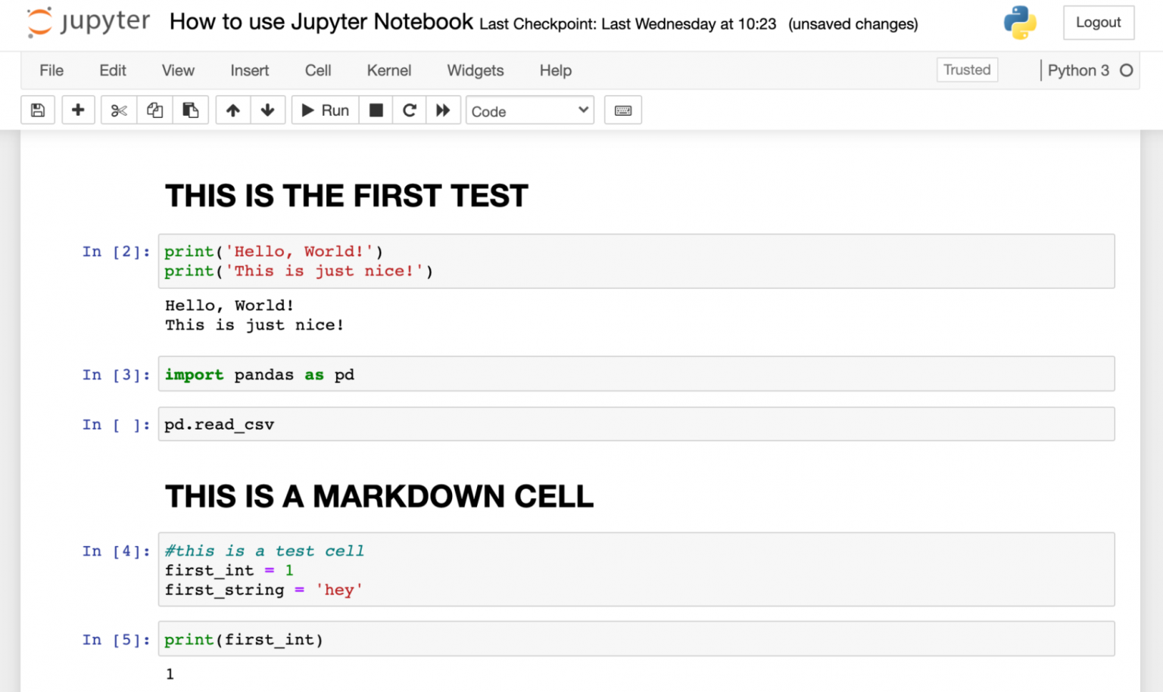
Module III Anaconda
Jupyter Notebooks and Jupyter lab

Slide 48
Introduction to Jupyter Notebooks
Interactive notebooks: Combine code, explanations, visualizations in one document.
Rapid prototyping & exploration: Prototype ideas, explore data interactively.
Share & collaborate: Share notebooks for easy explanation and collaboration.
Teaching and learning: Effective tool for teaching and learning data science concepts.
Open-source and language-agnostic: Free to use, supports various programming languages.

Slide 49
Getting Started with Jupyter
Easy installation: Use conda package manager for straightforward installation.
Create notebooks: Create new Jupyter notebooks for your specific projects.
Run code interactively: Execute code cells and see results displayed directly below.
Rich outputs: Visualize data and get textual output within the notebook.
Web-based interface: Access notebooks from any device with a web browser.

Slide 50
Jupyter Kernels
Execution engines for code: Kernels interpret and run code for specific languages.
Selecting the right kernel: Choose the kernel that matches your programming language.
Support for various languages: Run Python, R, Julia, and other languages in Jupyter.
Language specific functionalities: Leverage functionalities specific to each language.
Kernel connection: Jupyter communicates with the kernel to execute code.

Slide 51
Jupyter Architecture
Three core components: Notebook interface, execution kernel, and user interface.
Collaborative workflow: Code goes from notebook to kernel for execution, then results back to notebook.
Interactive environment: Enables interactive development and analysis.
Open architecture: Allows for customization and extension of functionalities.
Web technology foundation: Built on web technologies for broad browser compatibility.

Slide 52
Additional Anaconda Jupyter Environments
Isolate project dependencies: Use conda environments to manage dependencies for each project.
Version control: Manage different versions of libraries for specific projects.
Reproducible research: Ensure consistent environments for replicating research results.
Switching between environments: Easily switch between conda environments for different projects.
Environment sharing: Share conda environments for collaboration with specific setups.

Slide 53
Additional Cloud Based Jupyter Environments
Run notebooks on the cloud: Launch Jupyter notebooks on cloud platforms for easy access.
Scalable resources: Access powerful computing resources on the cloud for large datasets.
Collaboration from anywhere: Collaborate on notebooks from any device with an internet connection.
Cost-effective option: Pay only for the resources you use on cloud platforms.
Variety of cloud providers: Choose a cloud provider that best suits your needs.

Slide 54
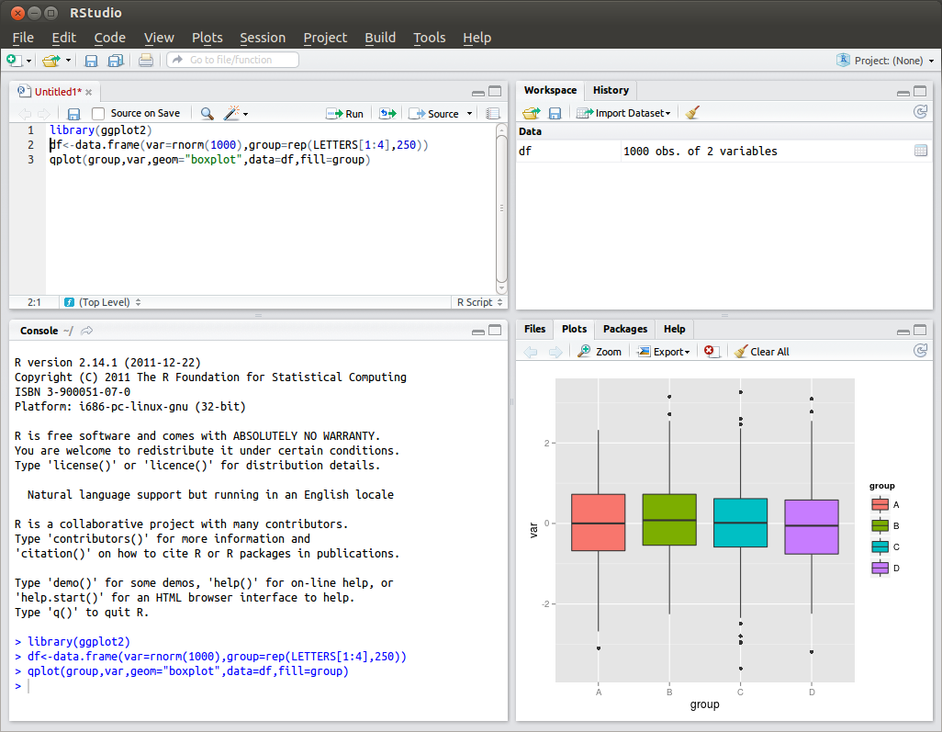
Module IIII GitHub

Slide 55
Introduction to R and RStudio
R Programming Language: Open-source language for statistical computing and graphics.
RStudio IDE: Integrated development environment for working with R.
RStudio functionalities: Code editing, data visualization, debugging, and more.
Benefits of using RStudio: User-friendly interface for efficient R development.
Focus on data science tasks: Streamline data analysis and visualization workflows.

Slide 56
Plotting in RStudio
R's rich graphics capabilities: Create various plots for data exploration and presentation.
Customization options: Extensive control over plot appearance and elements.
Interactive graphics: Create dynamic plots that respond to user interaction.
Integration with RStudio: Utilize RStudio's features for creating and managing plots.
Exporting plots: Save plots as images or other formats for sharing or reports.

Slide 57
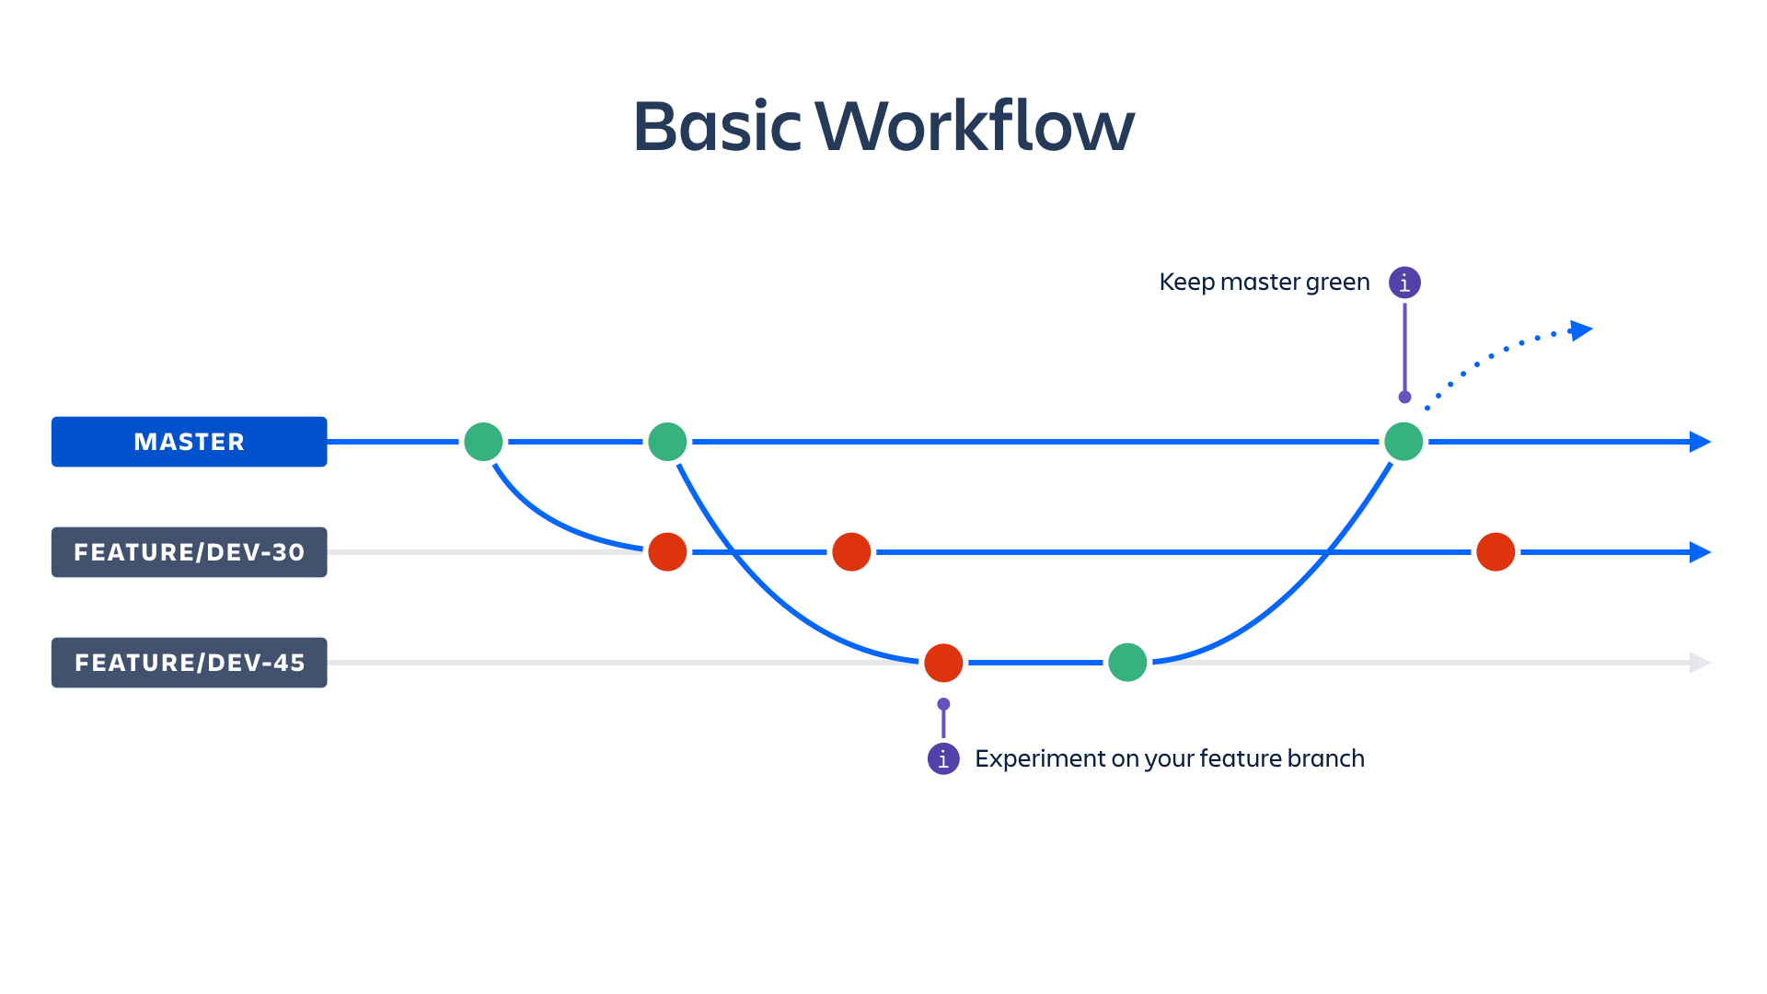
Overview of Git/GitHub
Version control system (Git): Track changes in code and data over time.
Collaboration platform (GitHub): Host code repositories and collaborate with others.
Benefits of using Git/GitHub: Version control, collaboration, and code sharing.
Open-source development: Facilitate open-source software development workflows.
Improved project management: Track project progress and manage different versions.

Slide 58
Introduction to GitHub
Online platform for hosting code: Create repositories to store and manage your code.
Version control with Git: Track changes and revert to previous versions if needed.
Collaboration features: Share code with others, discuss changes, and work together.
Public or private repositories: Choose to make your code publicly accessible or private.
Integrates with various tools: Works with Git and other developer tools.

Slide 59
GitHub Repositories
Fundamental unit of code storage: Organize your code projects in repositories.
Storing code and data: Store code files, data files, and other project assets.
Version history: Track changes made to files over time.
Branching and merging: Create separate development branches and merge them back.
Collaboration features: Manage access control, track issues, and collaborate on code.

Slide 60
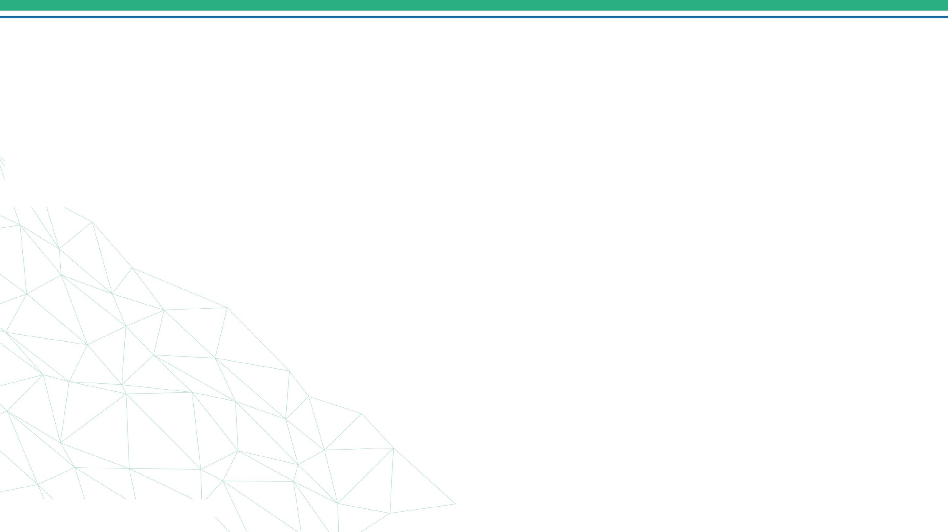



Questions & Answers
4/30/2024
34

Slide 61
Thank you!
4/30/2024
35

